Slide 1

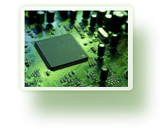


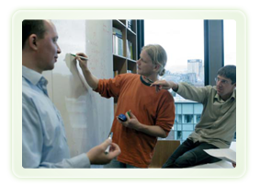




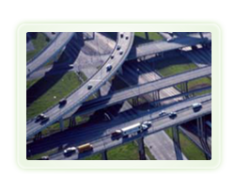



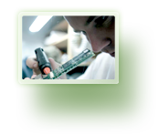


From imagination to impact

Slide 2







Track Assist
Design Notes 1.1
David Rawlinson
Notes:
Explain difference in title from advertised one and difference in emphasis

Slide 3
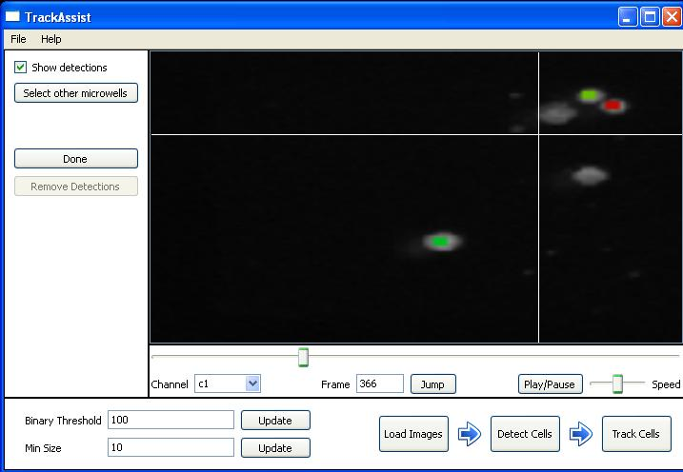
Progress Report + Objectives
Previously…
Delivered 3 incremental releases of prototype cell-tracking software
Automated cell detection for subset of cell imagery (circular / oval cells)
Automated & good tracking accuracy; detection accuracy inadequate...
Objective
Release commercial quality,
complete software solution
for a variety of popular cell-
tracking imagery methods,
by end 2011

Slide 4
Feedback
… on prototype software:
Would rather have better tools for correcting automated detection / tracking than more accurate automation.
In fact, would be happy to work without automation given good tools
Manually fixing the ~10% errors is prohibitively difficult in existing software programs, most offer limited interaction and simply export the tracking data.
Same problem with NICTA prototype; it only solves 90% of the problem!
This problem can be so severe it eliminates the value of automation entirely
Ongoing Research Problems
Need lots of accurate ground-truth data to objectively assess detection + tracking algorithms
But need good algorithms to generate a lot of accurate ground-truth data…!
Solution: Efficient manual tools to generate ground truth

Slide 5
Commercial-Grade Software Objectives
Usability (user time-efficiency)
Completeness (100% end-to-end solution)
Flexibility (works on a wide-enough range of cell imagery)
Quality (no frustrating limitations, bugs, crashes etc.)
Scale (allow collaborative & distributed work on shared datasets, central management of data files etc.)
Supportable (economical and feasible to support mass use of the system, cloud distribution models)

Slide 6
Timeline (The One Year Plan)
0.5Y to develop a manual-only cell-tracking solution (NO automation*)
0.25Y to add existing + latest automation tools for detection & tracking
0.25Y to test and scale the application for use as standalone desktop app. or multi-user cloud application**
* Yes, no automation. This is how we prove it’s a 100% end-to-end solution with viable user manipulation tools…We already know we can do a good job with the automation.
** Of course, we’re going to make it compatible with this from the start!

Slide 7
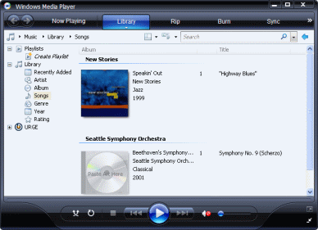
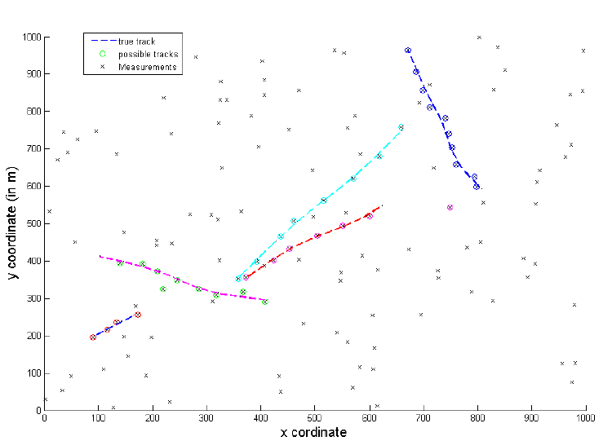
Design Considerations (1/7) “Media Player”
Cell imagery data is like a (long) video, but a video where you might want to edit every frame
Need precise and accurate control over frame playback
Understanding context of cell behaviour requires “window” playback (looping through a short sequence of frames centred on current time)
Overlay visualizations extending through a window of time, animated
Inspirations: Media player,
or video compositing software

Slide 8
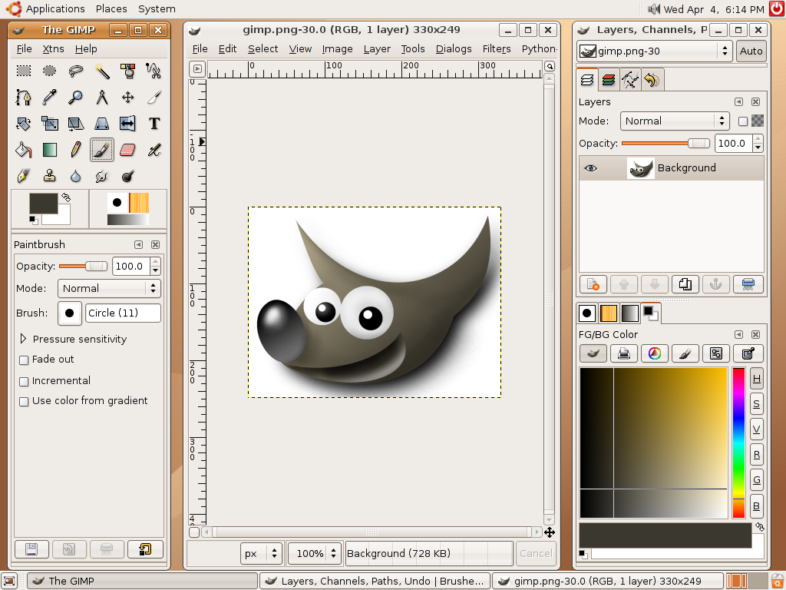
Design Considerations (2/7) “Photo-Shop”
Cell imagery data typically long sequences of very high resolution (multi-megapixel) images, .TIFF, .RAW or other lossless format
Need to pan / zoom into specific areas, closely examine blurry objects
May need to edit meta-data (detections, tracking) in every frame
Define cell segmentation at pixel or sub-pixel accuracy with easy tools – e.g. “magic wand”, shaped brushes, edit selected regions…
Need extendable toolkits to incorporate
newer, smarter tools for these tasks
Inspirations: Photoshop, GIMP,
other photo editing & special effects
software

Slide 9
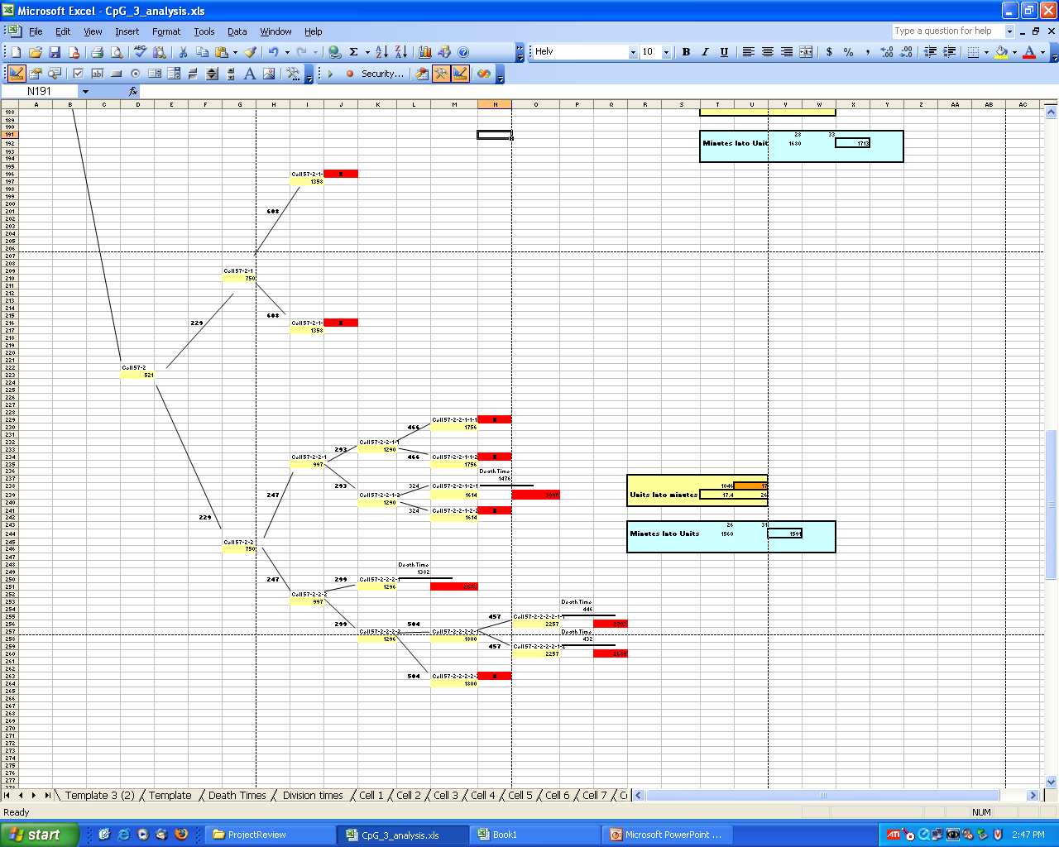
Design Considerations (3/7)
Domain-Specific Visualizations
Cell lineage trees (which cells related)
Charts of cell properties (motility, rate of division etc.)
Definition of “micro-wells” (independent experiments) within images

Slide 10
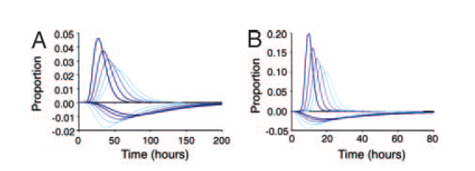
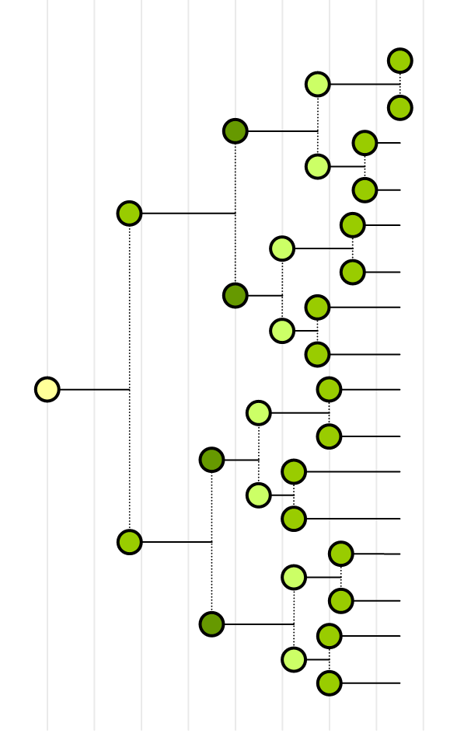
Design Considerations (3/7)
Domain-Specific Visualizations
Cell lineage trees (which cells related)
Charts of cell properties (motility, rate of division etc.)
Definition of “micro-wells” (independent experiments) within images

Slide 11
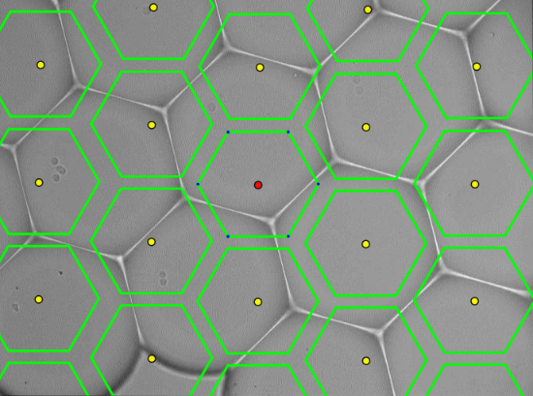
Design Considerations (3/7)
Domain-Specific Visualizations
Cell lineage trees (which cells related)
Charts of cell properties (motility, rate of division etc.)
Definition of “micro-wells” (independent experiments) within images

Slide 12
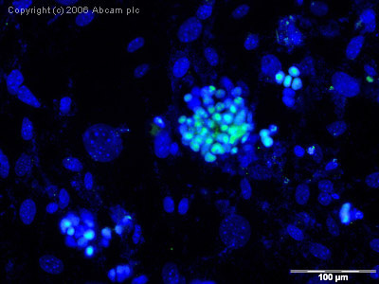
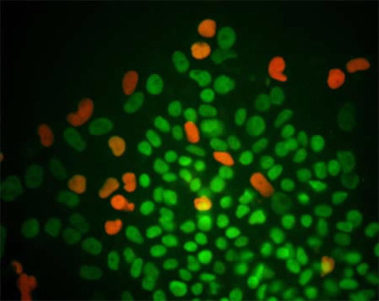
Design Considerations (4/7) Medical Imaging
12-bit TIFF / RAW images (as well as usual formats e.g. JPEG)
More than usual R/G/B or greyscale channels (e.g. fluorescence), sometimes 4 or 6 channels
Variable-depth (Z-axis) images (since cells are in a 3-D environment)
Issues due to camera stability, positioning precision
Can’t take images very frequently

Slide 13
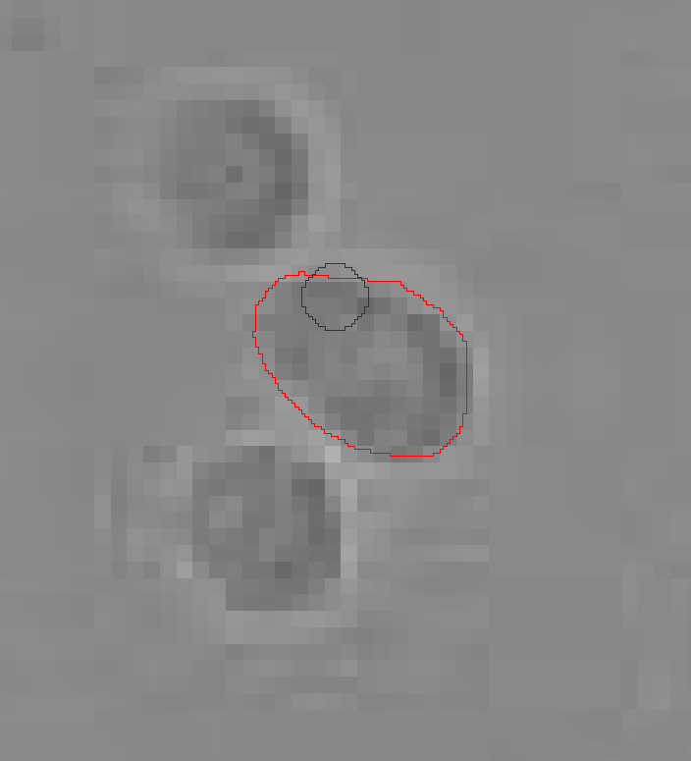
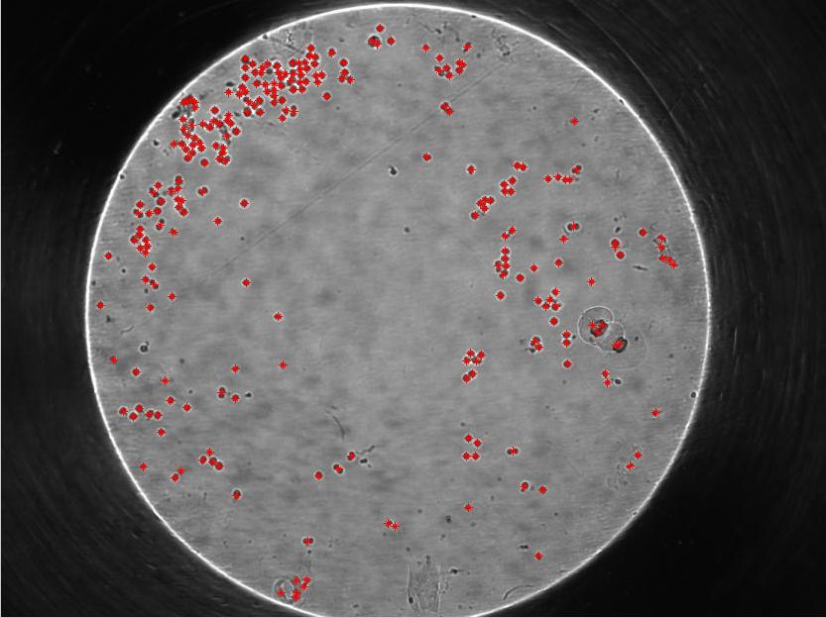
Design Considerations (5/7)
Interaction Efficiency
Need minimally time-consuming ways of segmenting X000s of cells
Similarly need to define tracks accurately, completely and quickly

Slide 14
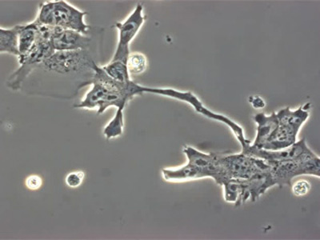
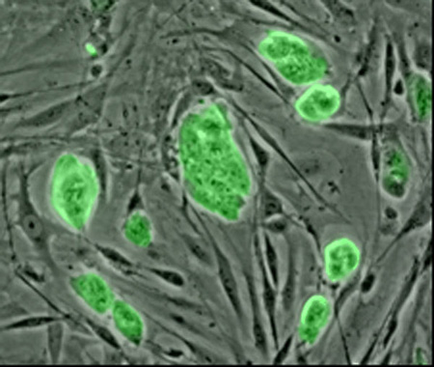
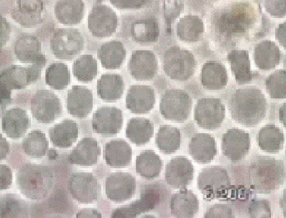
Design Considerations (6/7) Cell Variety
Easy to segment circular cells;
difficult to segment irregular ones
Some imagery has a lot of background
clutter, e.g. depending on whether cells
are in tissue samples …

Slide 15
Design Considerations (7/7)
Research Unknowns
How should tracking respond to user directions?
e.g. if user corrects a track, what forward and backward track corrections are implied? Can we recompute in realtime?
What input does software need from users? How can this be extracted in the most time-efficient manner? What’s easy for people? What’s easy for software?
How to assess accuracy? Cost vs. value while generating ground-truth:
Coarse = cell count per frame
Medium = cell count + position
Fine = cell segmentation area overlap

Slide 16
Process Outline
Microcope
Image
Capture
Export
/ Import
Images
Track
Assist
Export
Lineage
Data
Visualization
e.g. matlab
Statistical
Analysis
e.g. matlab
Want minimum steps in process from image capture to results analysis…
Focus in Track Assist is tracking
Researchers have ability/willingness to do their own visualizations & analysis once tracking data is complete & accurate…

Slide 17
Workflow Outline
Bulk
image load
Auto/Aided
Image Dims.
Auto/Aided
HDR→8bit
normalization
Auto/Aided
Detection
Aided
Association
Auto
Association
Auto/Aided
Segmentation
Export Tools
Visualization
??
Tracking
Tracking
research

Slide 18
Limitations in (original) TrackAssist
Fixed dimensions
Bulk
image load
Auto/Aided
Image Dims.
Auto/Aided
HDR→8bit
normalization
Auto/Aided
Detection
External,manual
Prescribed
naming
Aided
Association
Auto
Association
Auto/Aided
Segmentation
Limited
usability
Export Tools
Visualization
??
Needs improvement
Limited options
Limited

Slide 19
Bulk Image Load
Bulk
image load
Auto/Aided
Image Dims.
Auto/Aided
HDR→8bit
normalization
Auto/Aided
Detection
Data from microscopes organised as tree (folder structure), or flat (all images in 1 folder)
If neither of these, easy to paste into 1 folder of course…
Use filenames to extract patterns
Recognise patterns automatically!
Aided
Association
Auto
Association
Auto/Aided
Segmentation
Export Tools
Visualizations

Slide 20
N-Dimensional Image Sets
Bulk
image load
Auto/Aided
Image Dims.
Auto/Aided
HDR→8bit
normalization
Auto/Aided
Detection
Allow arbitrary number of image sequence dimensions (stage x,y, focus z, time t, channel c, etc.)
t
t
c0
x
x
y
y
c
t
t
x
x
c1
y
y
z0
z1
z

Slide 21
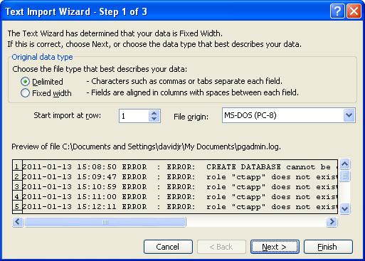
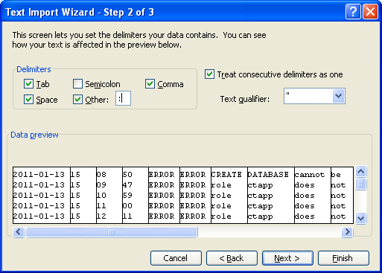
Auto & Human-Aided Dimension Description
Bulk
image load
Auto/Aided
Image Dims.
Auto/Aided
HDR→8bit
normalization
Auto/Aided
Detection
Example: Microsoft Excel:
Aided
Association
Auto
Association
Auto/Aided
Segmentation
Export Tools
Visualizations

Slide 22
High Dynamic Range Imagery
Bulk
image load
Auto/Aided
Image Dims.
Auto/Aided
HDR→8bit
normalization
Auto/Aided
Detection
Medical / microscope imagery high dynamic range, 12-16 bits per channel
Need specialist tools for handling these images
Convert to 8-bit range for further processing ASAP
Suggest initially provide 2 (automated) tools:
- linear mapping to 8-bit
- normal mapping to 8-bit
Aided
Association
Auto
Association
Auto/Aided
Segmentation
Export Tools
Visualizations

Slide 23
Platform Selection
Must allow collaborative working, delivery of software as cloud platform, data sharing (eventually)
Desire enterprise-grade data security / reliability / volume
Also need standalone single-user desktop application
Desire to write one solution for all scenarios
So…
Web technology seems appropriate
Application is graphically demanding
SQL database (agnostic, Postgres)
Java with Java Advanced Imaging (JAI) for image processing
Java Hibernate for database access
Java Swing can provide graphical interface for desktop or remote application

Slide 24
System Architecture
Heavy Java Client application
Local caching of images
Images stored in filesystem
Meta-data (detections & tracks) stored in DB
Software stack:
Swing
Java
Hibernate
ImageJ
Database
Filesystem

Slide 25
System Architecture
Standalone “desktop” application or cloud service:
Either way, user experience is the same.
Swing
Java
(client)
ImageJ
IP network
Java (web-server)
Hibernate
ImageJ
Database
Filesystem

Slide 26
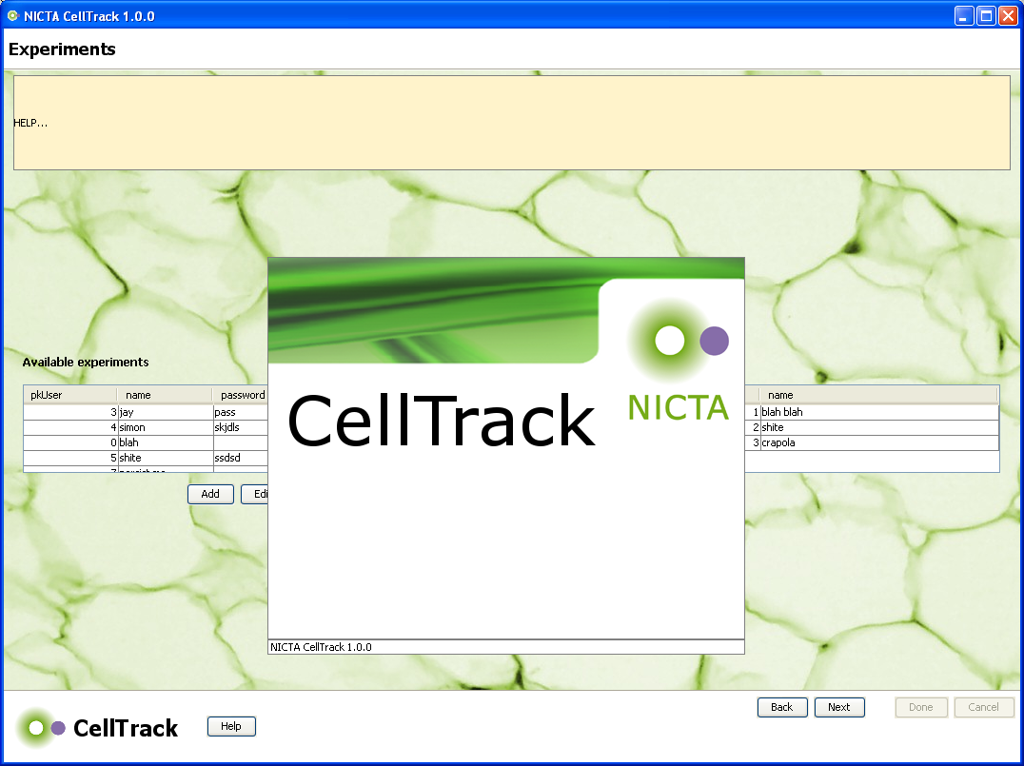
Current Look & Feel
TrackAssist

Slide 27
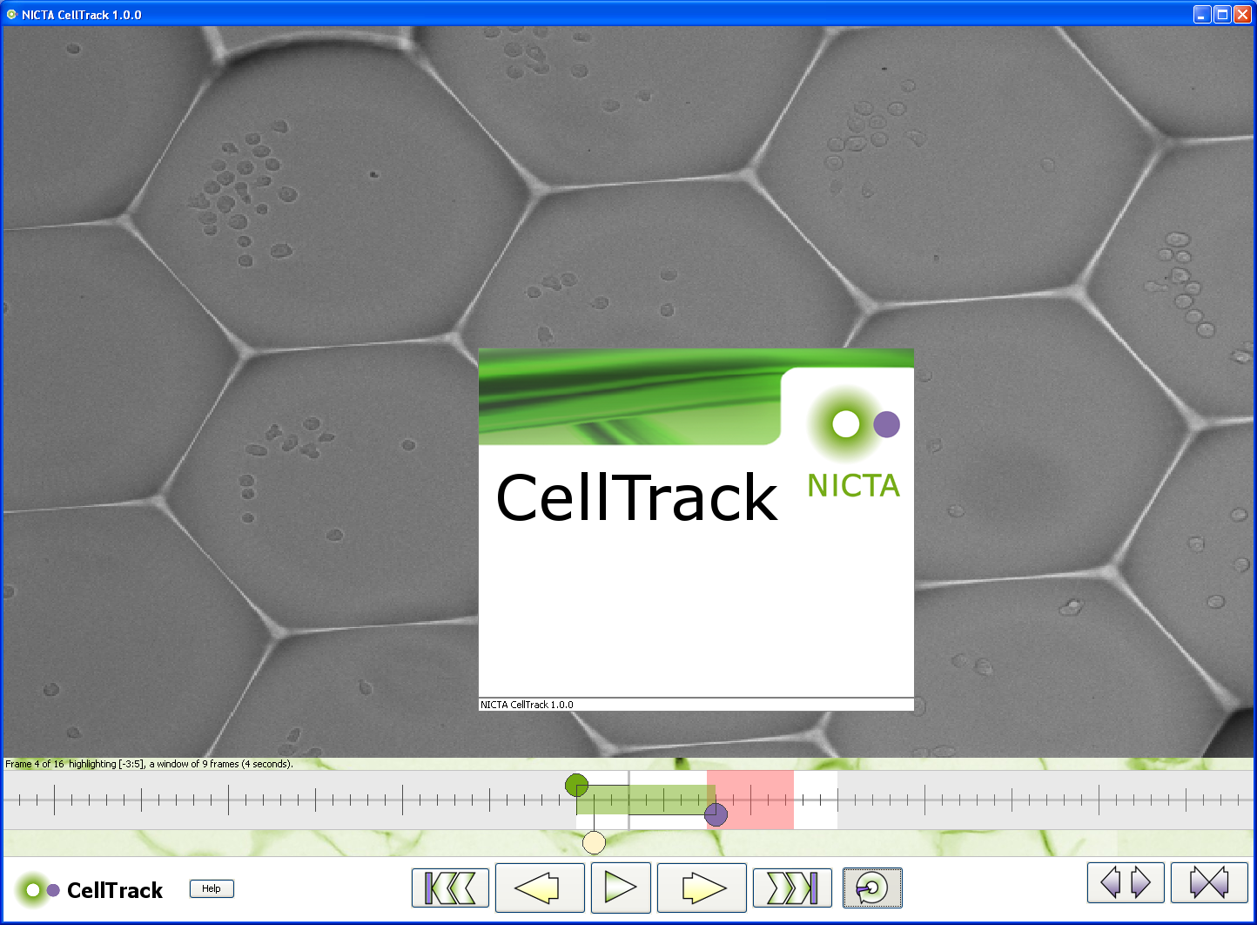
Current Look & Feel
TrackAssist

Slide 28
Current Status
Almost completed N-dimensional HDR any-format, pan/zoomable image sequence player
Some progress on UI for definition of imagery dimensions
Basic framework of application in progress
Some progress on extensible toolkits for image manipulation (segmentation)
Some progress on nice/easy microwell definition UI
DEMO: (Alan)

Slide 29
Finish
Questions…

